Slide 1
Shopping Cart App

Slide 2
Objective
Developing Shopping Cart App to learn End to end functioning of adding items into cart in reactjs, this will help in building E-commerce Web-App

Slide 3
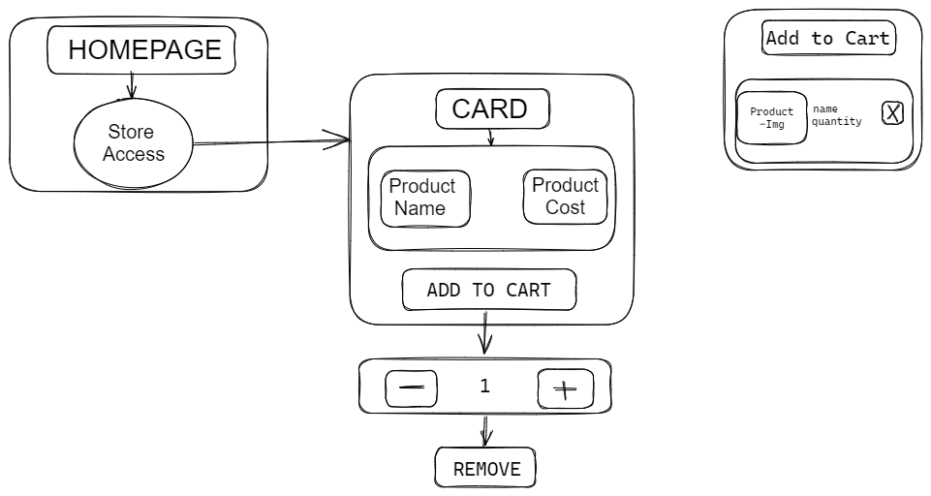
Architecture

Slide 4
Data Source
Used useContext hook to manage State Globally.
Used TypeScript to handle Errors.
Used useLocalStorage Hook to store data into local storage of the particular System

Slide 5

Technology used
Html, JavaScript, Reactjs, TypeScript

